Slide 1
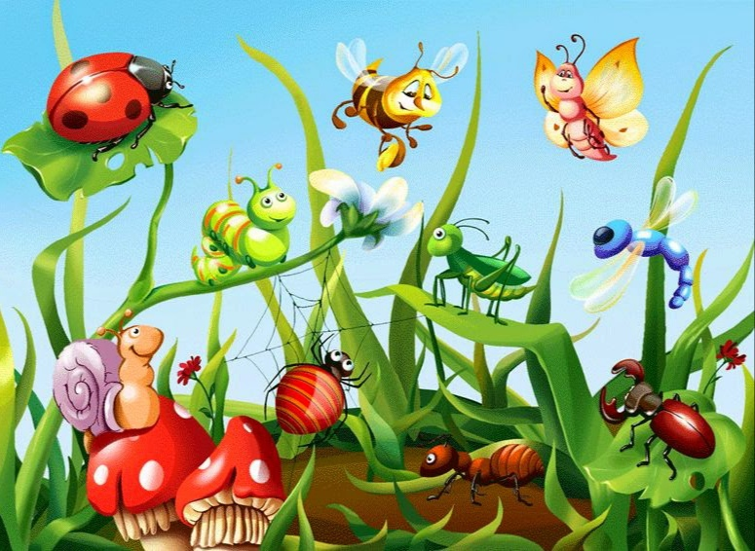

Slide 6
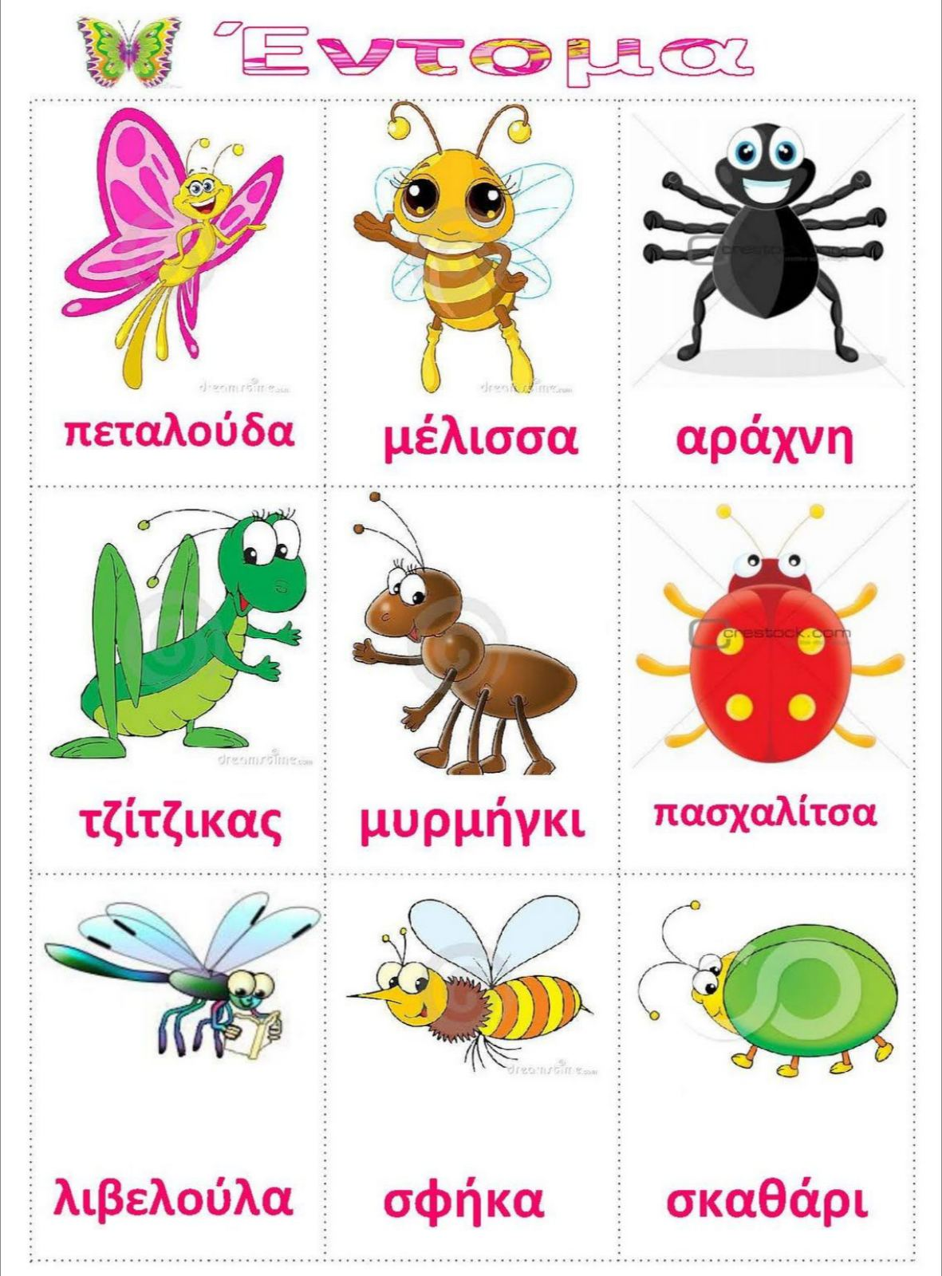

Slide 7
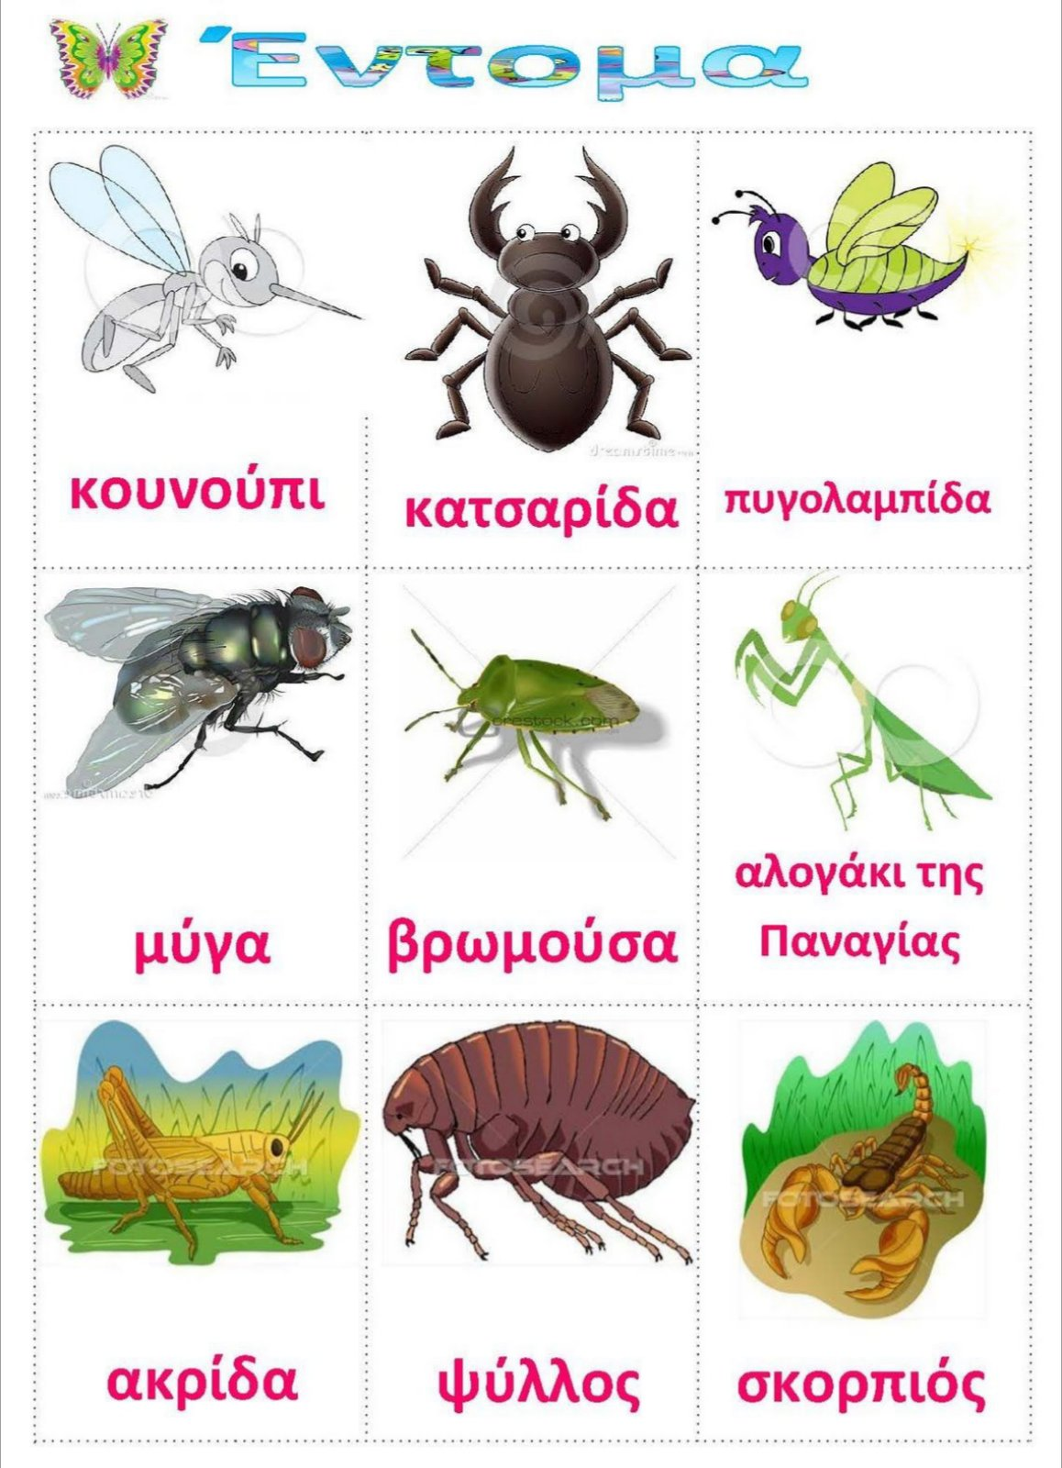

Slide 8
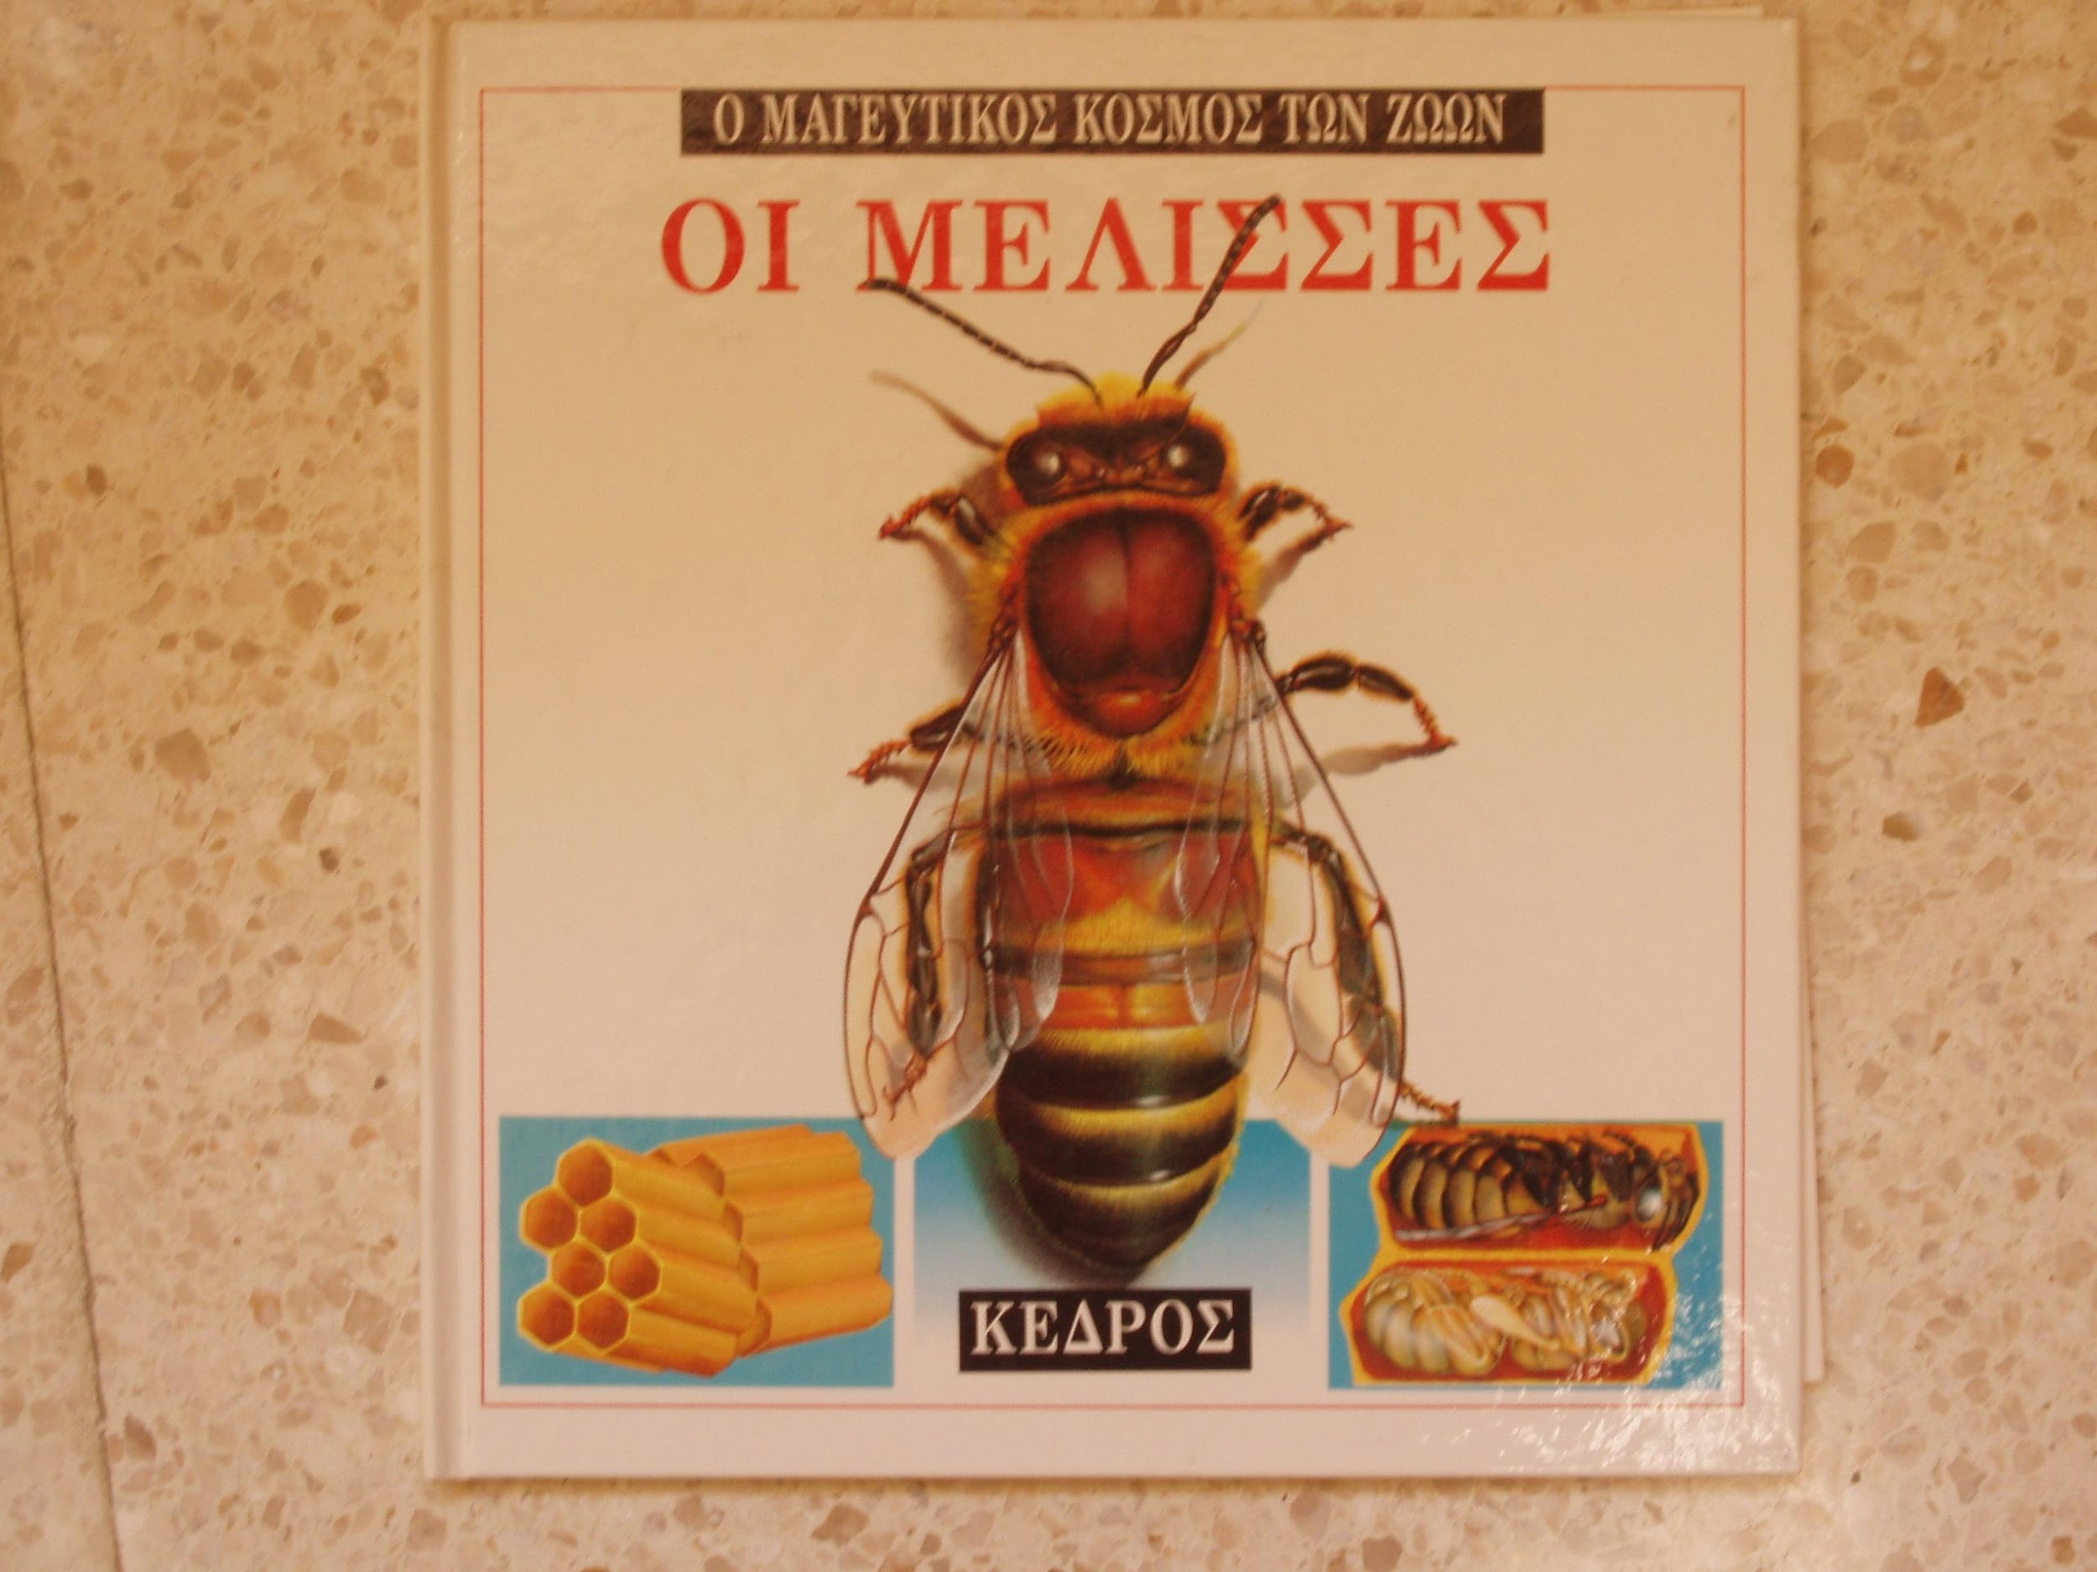
https://drive.google.com/file/d/0BxJ1LQ4ypMlwNEFOcGdFSkRrRUk/view?usp=sharing

